Slide 1
Travel Guide
By
Rishikesh

Slide 2


Agenda
A
Introduction
Existing Solution
Proposed Solution
Software Requirements
Frontend and Backend
Modules and Screenshots

Slide 3
Introduction
Welcome to our travel guide website, your ultimate resource for exploring the world's most captivating destinations. Whether you're planning a solo adventure, a family vacation, or a romantic getaway, our site offers a wealth of information to help you make the most of your travels. Discover detailed guides, insider tips, and must-see attractions for destinations across the globe. Our platform is designed to inspire and assist you every step of the way, ensuring your journey is seamless and unforgettable. Start your adventure with us and uncover the wonders the world has to offer!

Slide 4
Existing Solution
Detailed articles on popular destinations worldwide, highlighting major attractions, local culture, dining options, and accommodation recommendations..
Real feedback from travelers who have visited various places, offering honest insights and tips to help others make informed decisions.

Slide 5
Proposed Solution
Personalized Recommendations: Utilizing AI algorithms to suggest destinations, attractions, and activities based on users' preferences, past travel history, and site behavior.
Custom Itineraries: Automatically generated itineraries tailored to individual interests, travel style, budget, and available time.

Slide 6
Software Requirements
The software required are
Web browser-Google Chrome
ReactJS, CSS, Javascript, ExpressJS
VS Code - IDE
MongoDB Atlas

Slide 7
Modules
The Modules are
home Page
Travel collection Page

Slide 8
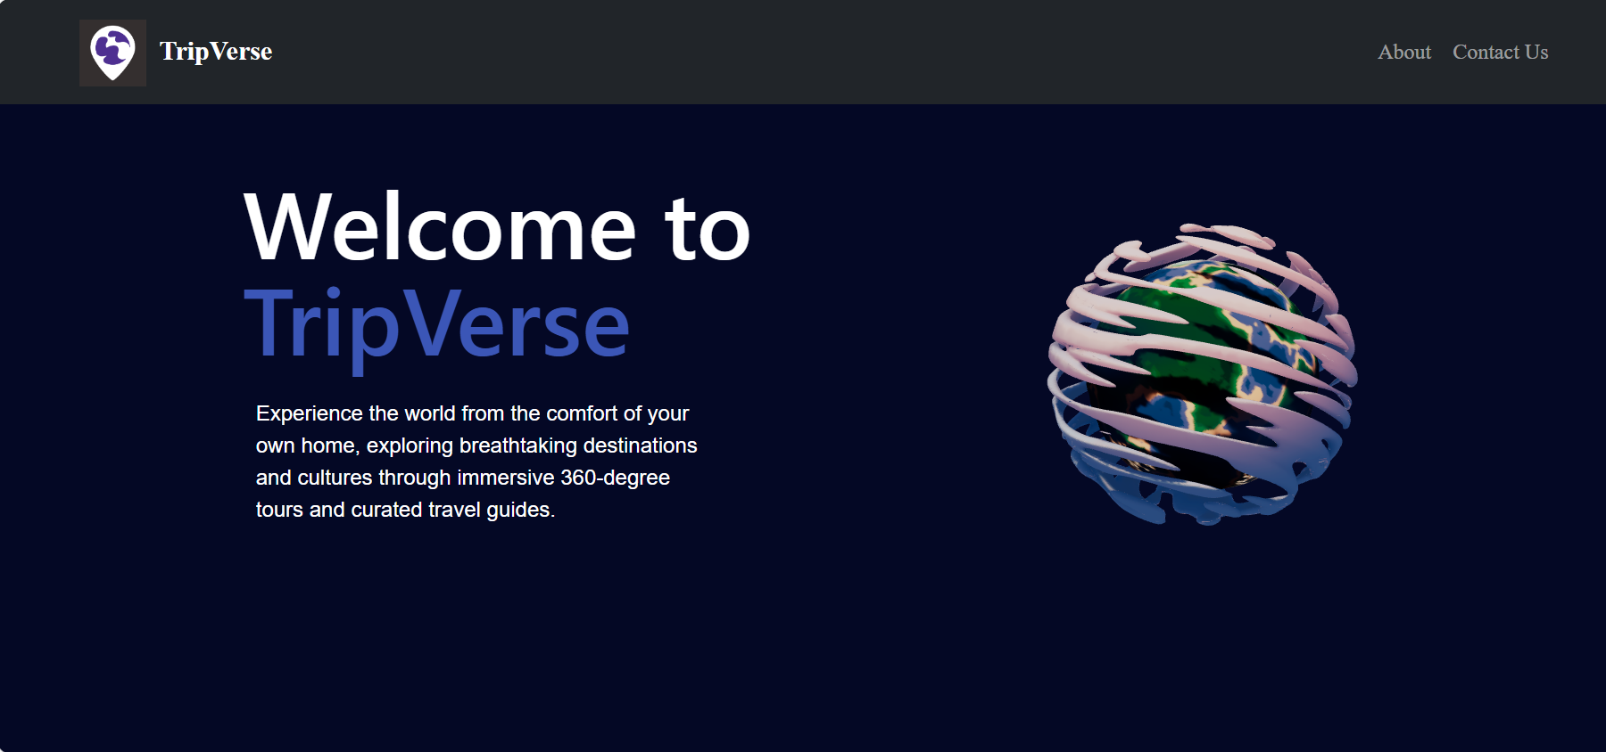
Home page

Slide 9
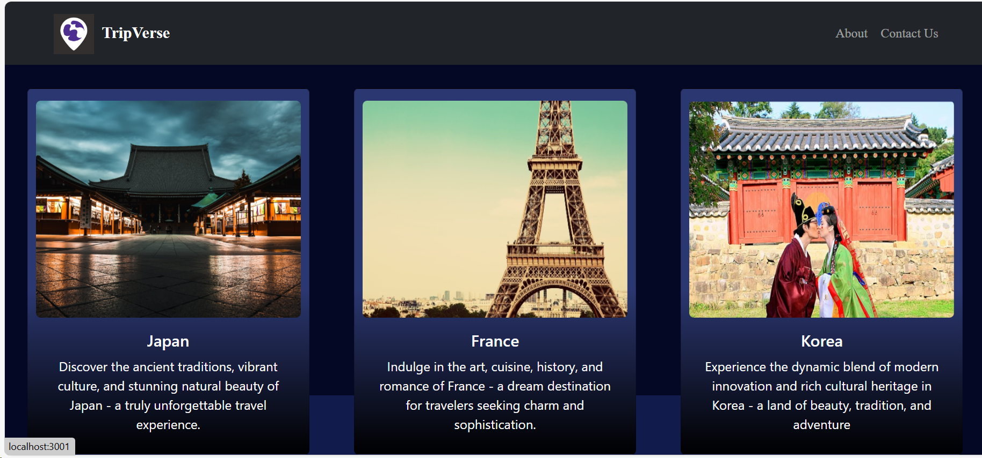
Movie Collection Page

Slide 10
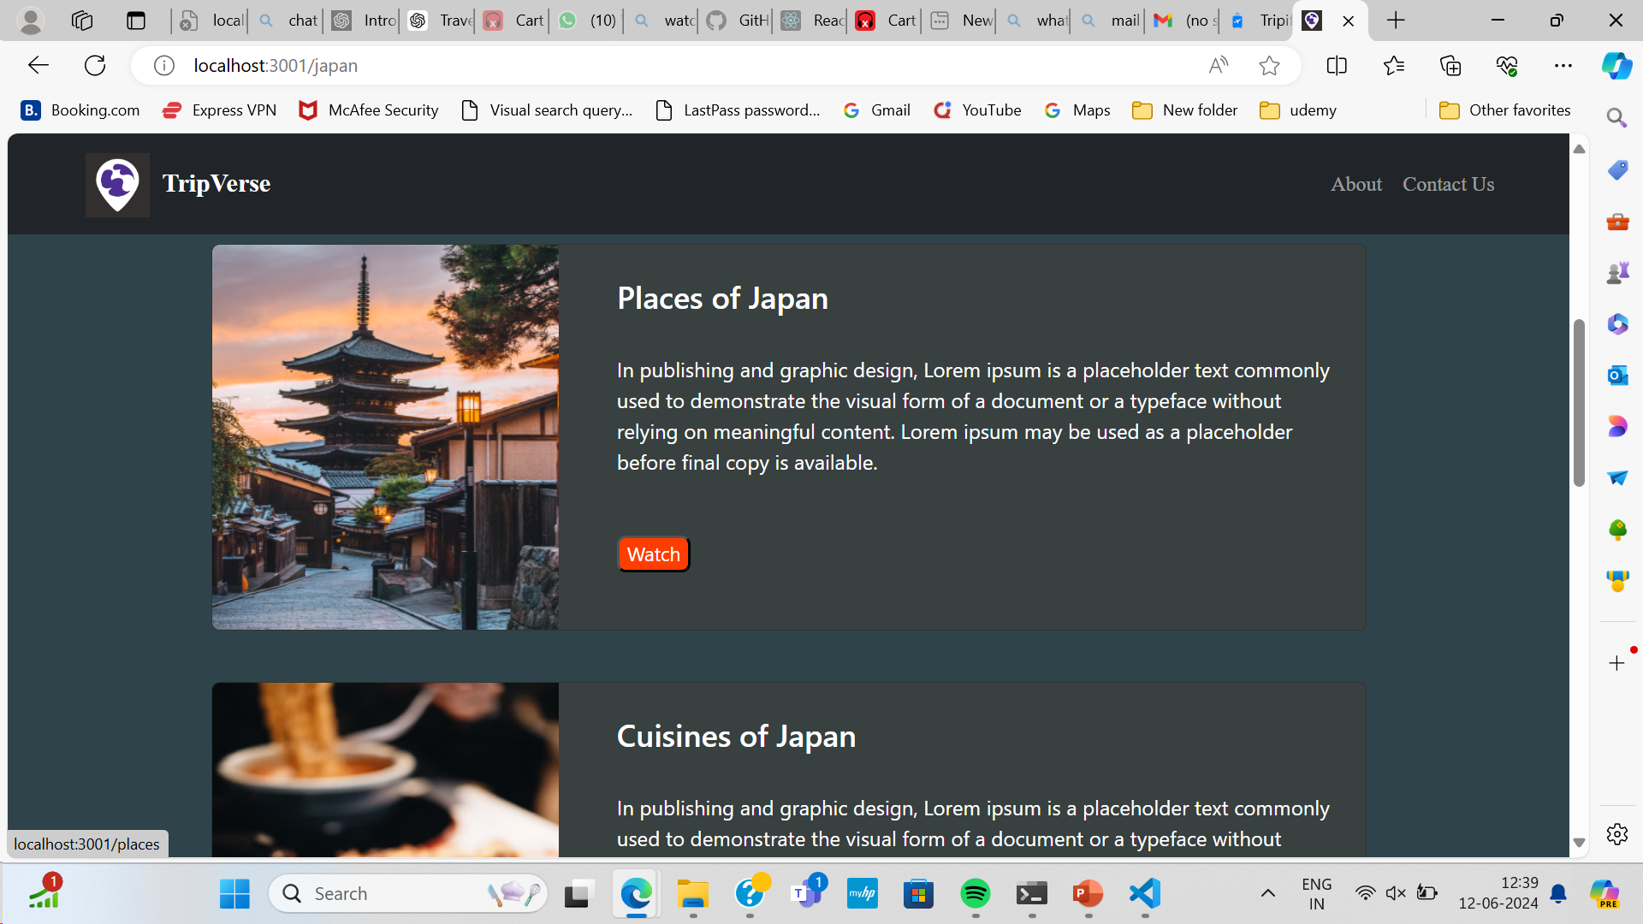
Frontend Output Screenshots

Slide 11
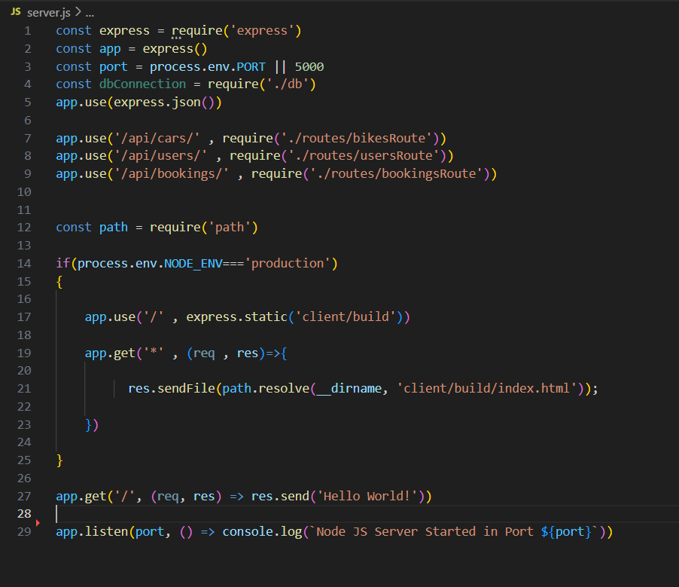
Backend Code Screenshot

Slide 12
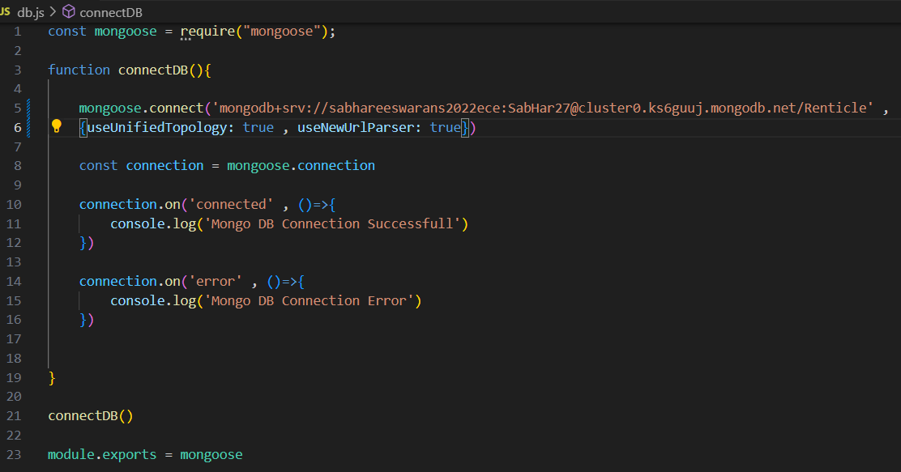
Database Connectivity Screenshot

Slide 13


